Slide 1

“BELIEF + HARD WORK + SUPPORT = SUCCESS.”

Slide 2
What is Hegarty Maths?
An online platform for all year groups to help you learn, practice and revise maths;
Each topic is broken into tiny pieces with a video and a quiz to test your understanding
Topics range from simply learning your times tables all the way through to grade 9 topics at GCSE.
There is something for everyone!

Slide 3
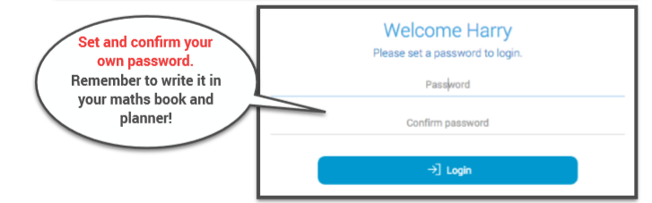
How do you login?
Search for St Peter’s School
(It’s easiest to type in PE29)
Type in your first and last name and your dob
Create a password (if you login for the first time)
Otherwise, type in your password.

Slide 4
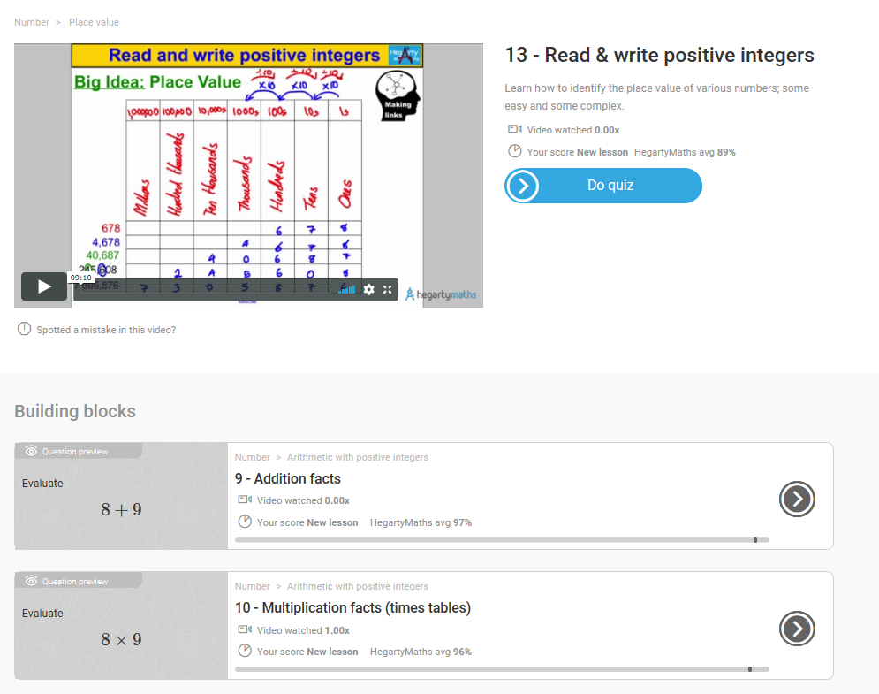
What does studying look like?
A video explaining the topic by a real maths teacher
A self-marking quiz that is directly related to the video – no trick questions
Building blocks – don’t understand the video? Building blocks show you the topics you need to understand BEFORE you try this new topic. They act as more support for your learning.

Slide 5
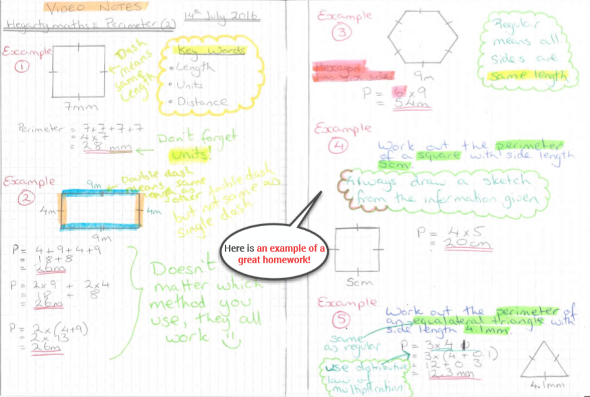
What does excellence look like?

Slide 6
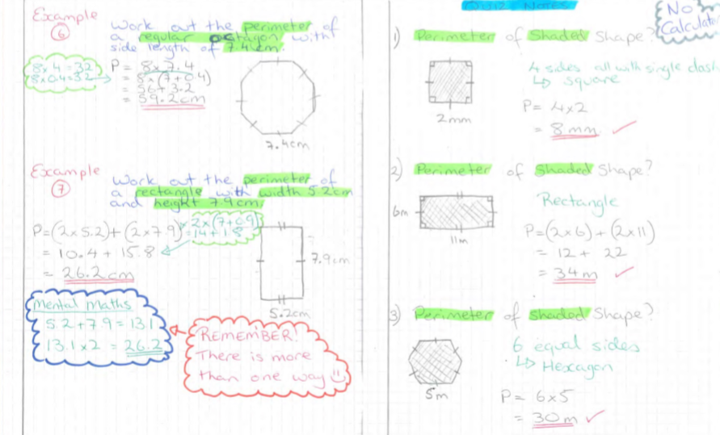

Slide 7
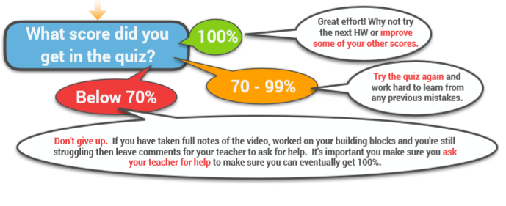
Notes:
This should be stuck on the inside cover of student books

Slide 8
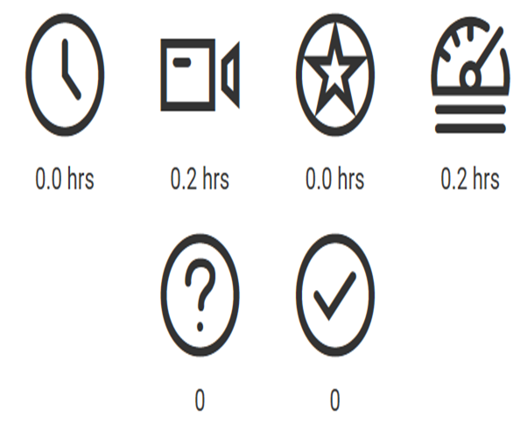
We are monitoring your efforts
Time spent in total
Total time watching videos
Total time spent on quizzes
Total time doing Fix Up 5s
17.2 hrs
20.1 hrs
15 hrs
52.3 hrs
Questions answered correctly
Minimum Target = 30 mins per week
Number of questions answered
1219
1096
Notes:
Talk about the metrics that we can follow and that these will be linked to rewards.
Students should be spending at least 30 minutes per week on Hegarty maths!!

Slide 9
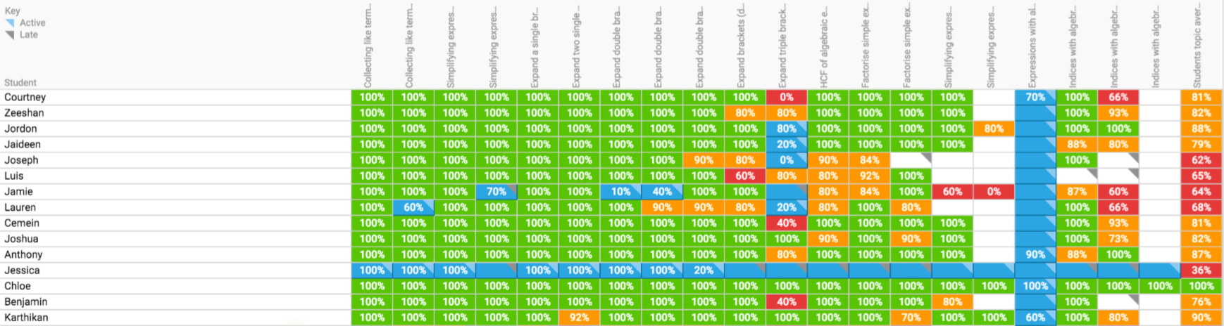
We can see your scores
What time of day you did it
How many times you watched the video
How many times you attempted it
Everyone’s actual answers to every homework

Slide 10
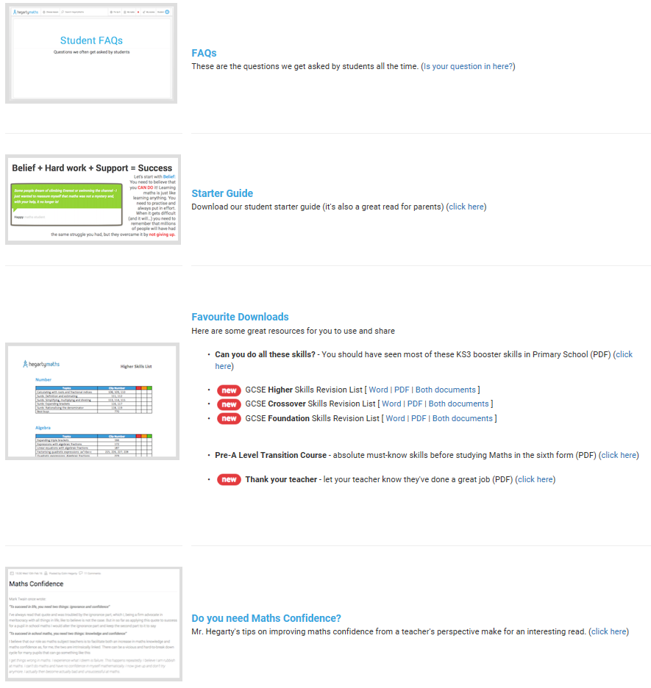
Support
There is student help section on the website

Slide 11
